Slide 1
Low Cost Virtual Animation Effects for Sports Broadcasting: Mosaics, Flags and Big-sized Flags
A. Denia, J. Ribelles, Á. López and Ó. Belmonte Institute of New Imaging Technologies, Universitat Jaume I

Slide 2
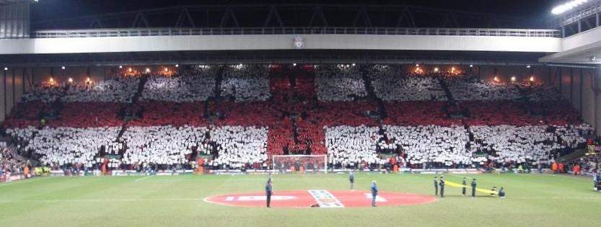
Motivation
We want to be able to easily add animation effects in real-time to make the broadcast of the event more spectacular.

Slide 3
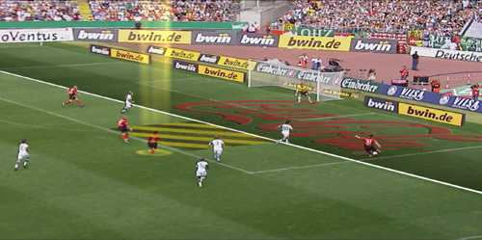
How can we do that now?
Commercial products:
BBC - The PIERO project, VIZRT - Viz Arena, RT Software - TOG Sports, etc.
Expensive and training is required

Slide 4
Goal
We aim:
to overlay animated computer-generated graphics during sports broadcast
to simulate some of the effects performed by the audience in the stands:
Mosaicing
Waving of little flags
Unfolding and waving of a big-sized flags

Slide 5
Mosaicing

Slide 6
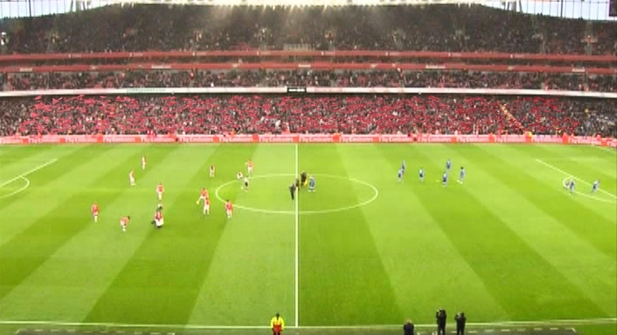
Little flags

Slide 7
Big-sized flag

Slide 8
Challenge
To develop a simple method using low-cost graphics hardware, enabling to any TV production company to use it
Visual realism, so that the animation seems actually performed by the audience
Real-time, current graphics hardware has proved to perform well for real-time rendering

Slide 9
The proposal
We define:
A common geometry model
To represent the arrangement of the stands, spectator absences, heights, etc.
A construction process for each effect
Instantiate the geometry model to the particular characteristics of each effect: size, textures, type of movement, etc.
A common animation process by means of a Shader
Three stages: appearance, exposition and disaearance
Use of a noise function to modify sahpe and position of the objects

Slide 10
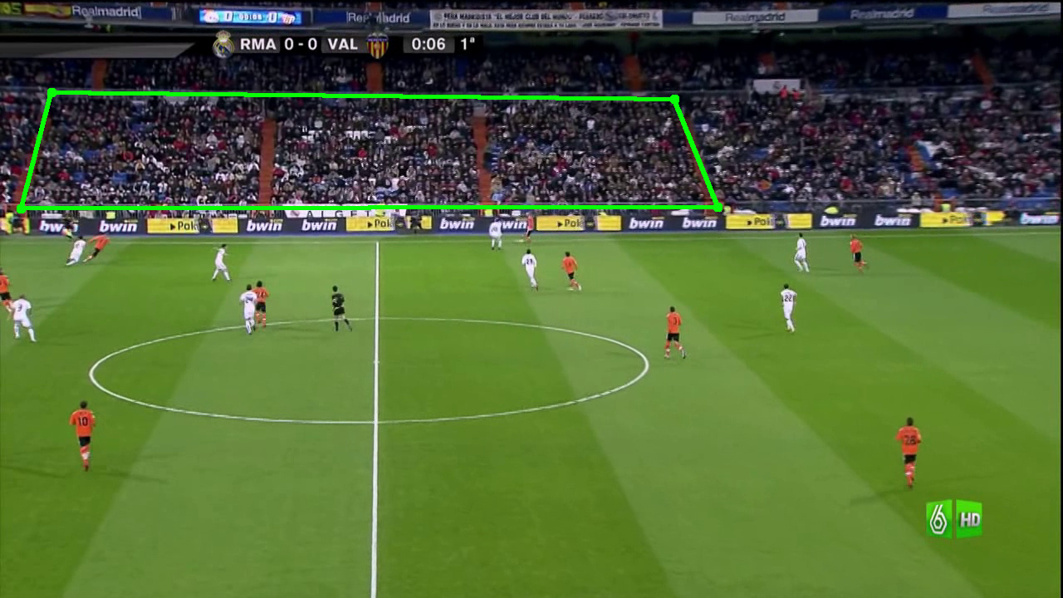
What about the tracking?
The user picks on the display the corners of the area where the animation effect will be overlaid.
We use the Lucas-Kanade method.

Slide 11
Tracking example

Slide 12
Mosaics, description
We consider these issues:
The tesseras are not raised simultaneously
Lack of spectators
The spectators have different heights
The tesseras cannot remain still
Change of tesseras for displaying different contents
Mosaic descent will not be simultaneous

Slide 13
Mosaics, construction
The mosaic is represented as a tessera matrix with the size of the stands
We use a mask to mark tesseras not to be shown:
Steps, gates, empty seats, etc.
We apply random vertical displacement, using the Box-Muller transform, to simulate height differences

Slide 14
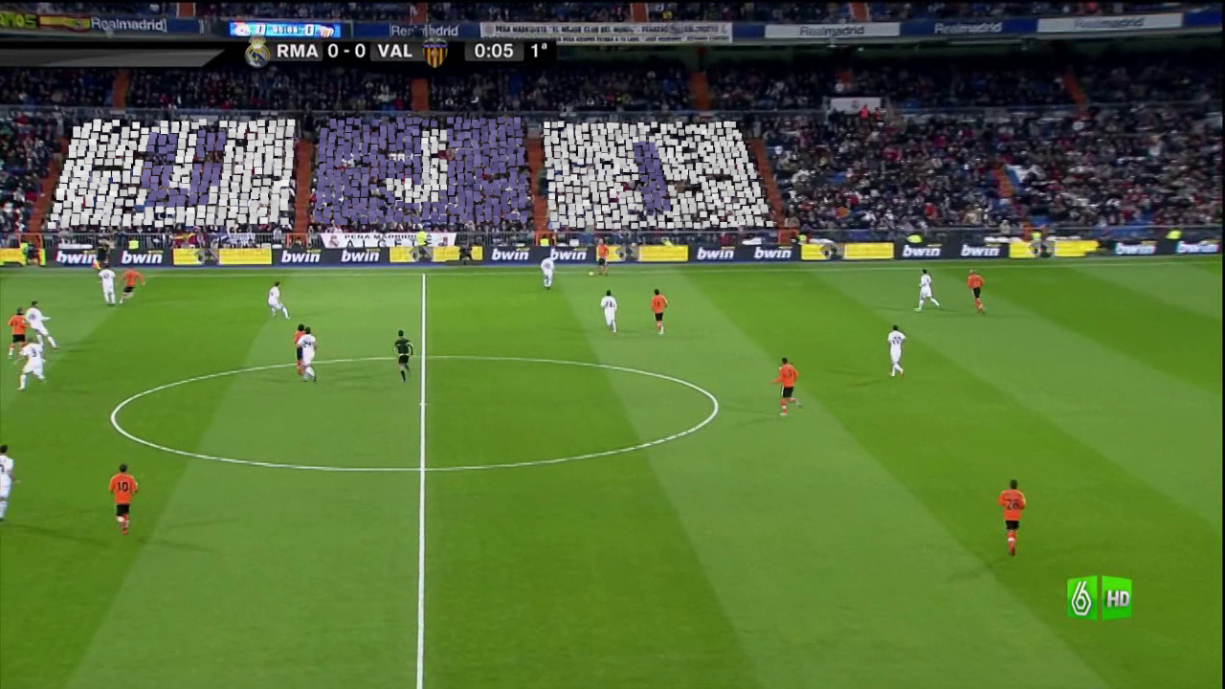
Mosaics, animation

Slide 15
Little flags, description
We consider these issues:
The absence of flags is higher than that of tesseras
The size of the flaig is variable
Each flag show an image
The movement of a flag is stronger than tesseras swinging

Slide 16
Little flags, construction
The model is identical to that of the mosaic
The masking matrix is also used to mark the type of flag
To simulate a higher movement, we just increase the amplitude of the noise function

Slide 17
Little flags, animation

Slide 18
Big-sized flag, description and construction
We consider these issues:
All the pieces are connected
The absence of spectators is not considered
The audience pushes the flag upwards above their heads
Unfolding and folding are simulated
The masking matrix is not necessary

Slide 19
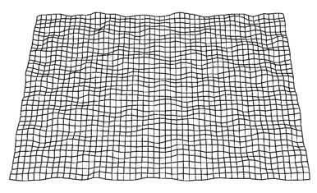
Big-sized flag, animation

Slide 20
More results
Video show

Slide 21
Conclusions and future work
We have presented a technique to simulate the animation effects performed by the audience in the stands of a stadium
We take into account issues like absence of spectators, height and movement
The animation is processed in real-time
Visual results are quite satisfactory
We plan:
To research the simulation of other effects: domino,…
To improve the tracking system

